Slide 1



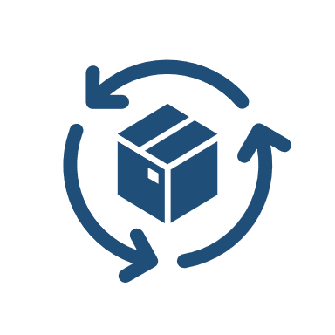




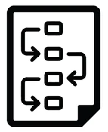
Discovery objectives & approach
Architecture
Current Enterprise architecture w.r.t systems, infrastructure, integration & Data
Architecture strategy, goals and considerations
Monitoring, security & Governance
Challenges/Concerns/Problems
Infrastructure and Enterprise Architecture
Architecture gap analysis
Our Understanding report
Solution approach to establish Well Architected API driven Architecture
Solution approach for DevOps
VM Value-add areas
High level proposal
Applications & Integration
Agency and customer portals
Outbound, Inbound and Internal Integrations
Tools, Technologies, Frameworks & Patterns
State of API Gateway & Management
Development methodology & Governance
Outcomes
Portals, outbound, inbound and internal integration
Primary Focus Areas
Current Infra provisioning & configuration
Current build & deployment process
Environment Topology
DevOps strategy & considerations
Current state of automation testing
DevOps
Infrastructure, process and deployment automation
Initiation
Analysis
Review
Action Plan

Slide 2
Detailed activities
Phase | Day | Activity | ~Duration | Involvement from Direct Asia
Initiation | Day 1 | Kickoff meeting Seek & review any existing documentation Plan, schedule & review stakeholder meeting | 6 to 8 hours | Direct Asia SPOC – 2 to 4 hours
Analysis | Day 2 | Architecture: Understand current IT Landscape and Architecture Current Enterprise architecture w.r.t systems, infrastructure, integration & Data Architecture strategy, goals and considerations Potential challenges, issues and assess for future needs | 6 to 8 hours | Enterprise Architect – 2 to 4 hours
 | Day 3 | Core & Non-Core System: Gain high-level understanding of Enterprise & External applications in terms of technology/tool and integrations. Core System and Its integrations Document Generation and Print System CRM, GL and Lead management External applications/services | 4 to 6 hours – for each application | Enterprise Architect Core System Architect/ Lead – 2 to 4 hours
 | Day 4 | APIs/Integration: Capture details on current Direct Asia Integration landscape Architecture, Environment Topology & deployment process Patterns implemented High level information on applications/system integrated Current API Management capabilities that are enabled Security, Governance & challenges | 6 to 8 hours | Integration Architect – 2 to 4 hours

Slide 3
Detailed activities
Phase | Day | Activity | ~Duration | Involvement from Direct Asia
Analysis | Day 5 | Infrastructure & App Support Understand current infrastructure landscape, process to provision and configure and deployment process. Current Infra provisioning & configuration Current build & deployment process Environment Topology DevOps strategy & considerations | 4 to 6 hours | DevOps Team – 1 to 2 hours
 | Day 6 | Testing Gather the details on Direct Asia’s current maturity of automation testing and the strategy that they have. Gain understanding on current application and API testing | 2 to 4 hours | Testing Team – 1 to 2 hours
 | Day 6 & Day 7 | Data Understand Enterprise data functional & technology landscape and strategy Gather current initiatives and challenges Enterprise Data Warehouse design | 4 to 6 hours | Data Team/Enterprise Architect – 2 to 4hours
Review | Day 8 | Identify the gaps, issues, review the understanding Discuss, document, ensure coverage and seek feedback Present the understanding to all stakeholders Describe the areas where ValueMomentum can add value | 6 to 8 hours | Direct Asia SPOC – 2 to 4 hours
Action Plan | Day 9 & Day 10 | Complete & deliver the Understanding report Draft & present high-level proposal and seek feedback Discuss on the next steps | 6 to 8 hours | Direct Asia SPOC – 2 to 4 hours

